Slide 1
EscrowLance
Decentralized Freelance Marketplace
Presented by: OWOLABI ISRAEL
( TTOICRAFT )

Slide 2
Problem Statement
Lack of trust between freelancers and clients
Decentralized control over payments and user data
Limited recognition and proof of reputation for freelancers

Slide 3
Our Solution
ESCROLANCE is a decentralized platform that ensures trust, transparency, and fair compensation for freelancers using smart contracts, on-chain reputation, and NFT recognition.

Slide 4
Core Features
Smart contract-based escrow system
On-chain reputation for freelancers
Milestone-based NFT badge awards
Utility token (dJOB) for payments

Slide 5
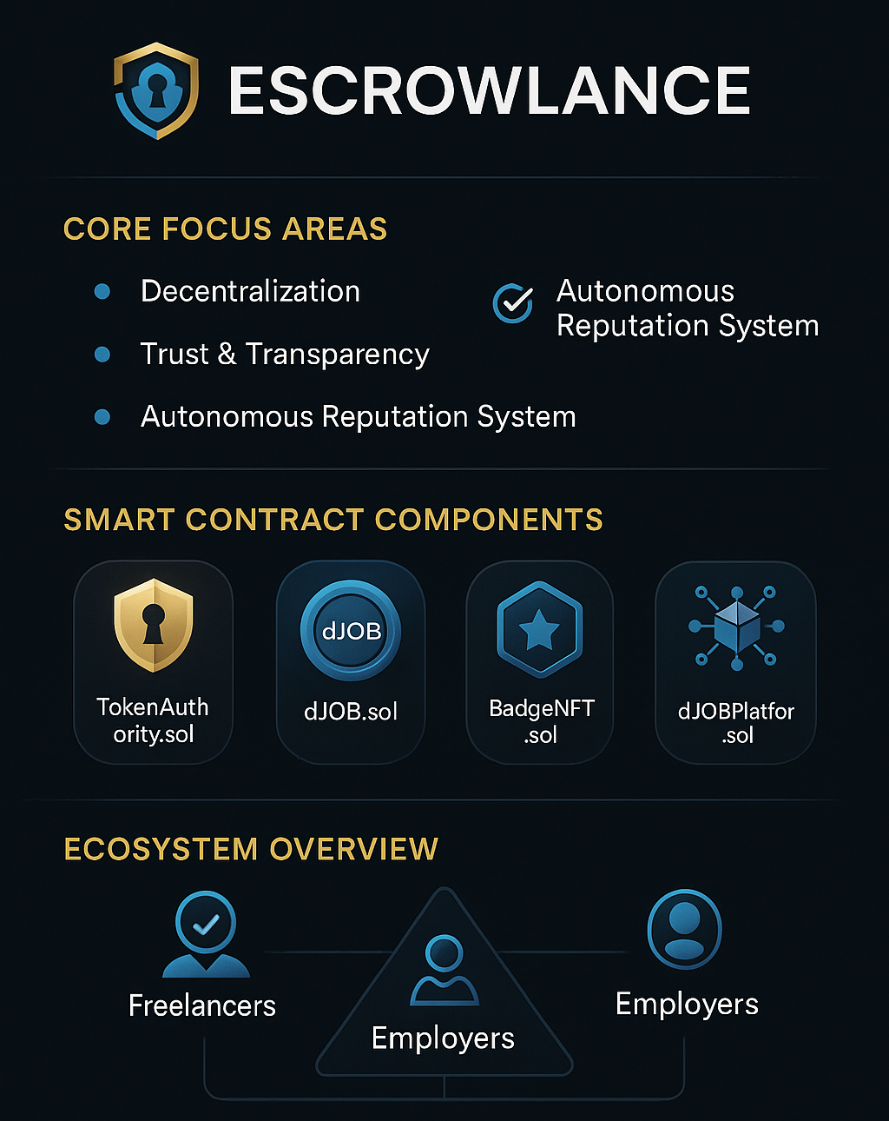

Slide 6
Web3 Integration
Wallet-based access (no passwords)
Ethereum-compatible smart contracts
Full transparency and immutability of data
Interplanetary File System ( IPFS ) for NFT metadata and badge assets

Slide 7
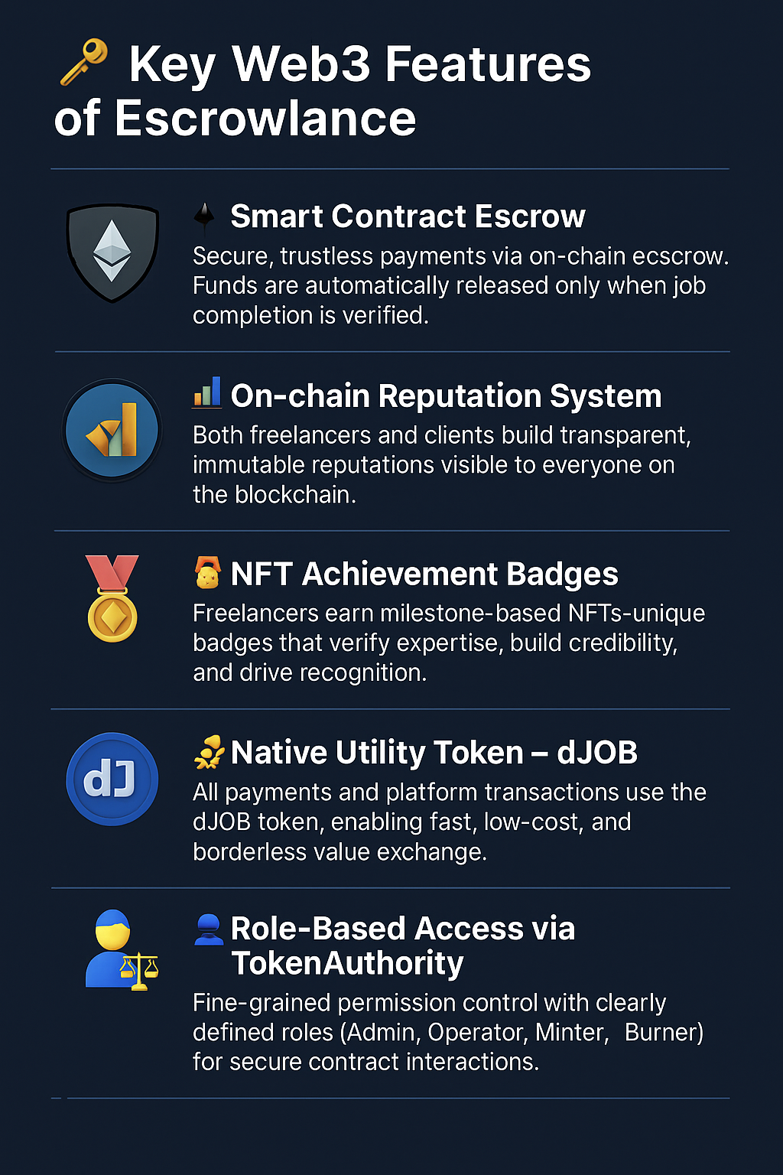

Slide 8


Slide 9
Smart Contract Architecture
dJOB Token (ERC-20): Payment currency
BadgeNFT (ERC-721): Freelancer achievements
TokenAuthority: Role-based permissions
dJOBPlatform: Core freelance logic

Slide 10
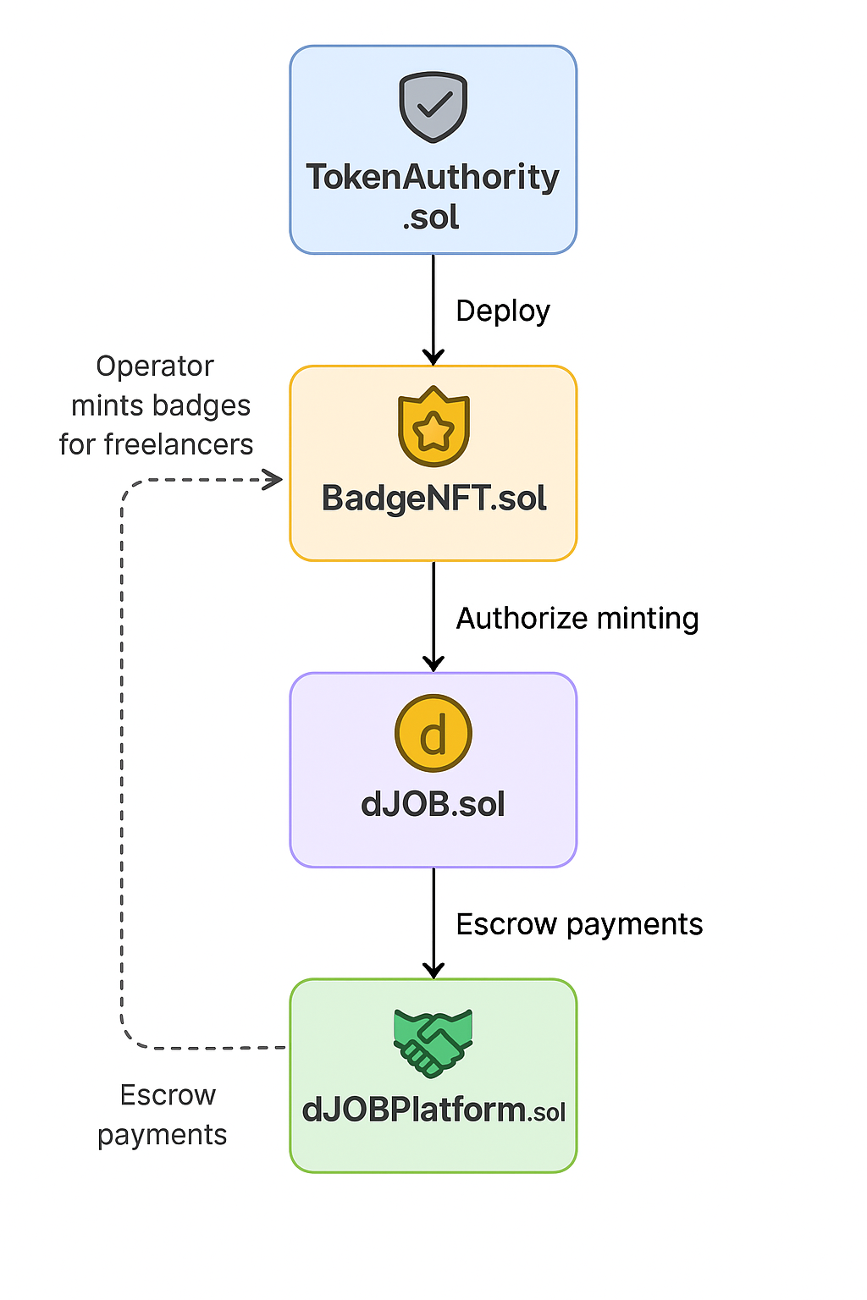

Slide 11
Workflow Overview
Employer creates a job and deposits tokens
Freelancer accepts the job
Upon completion, employer confirms
Tokens are released to freelancer
Freelancer gains reputation points and NFT badge

Slide 12
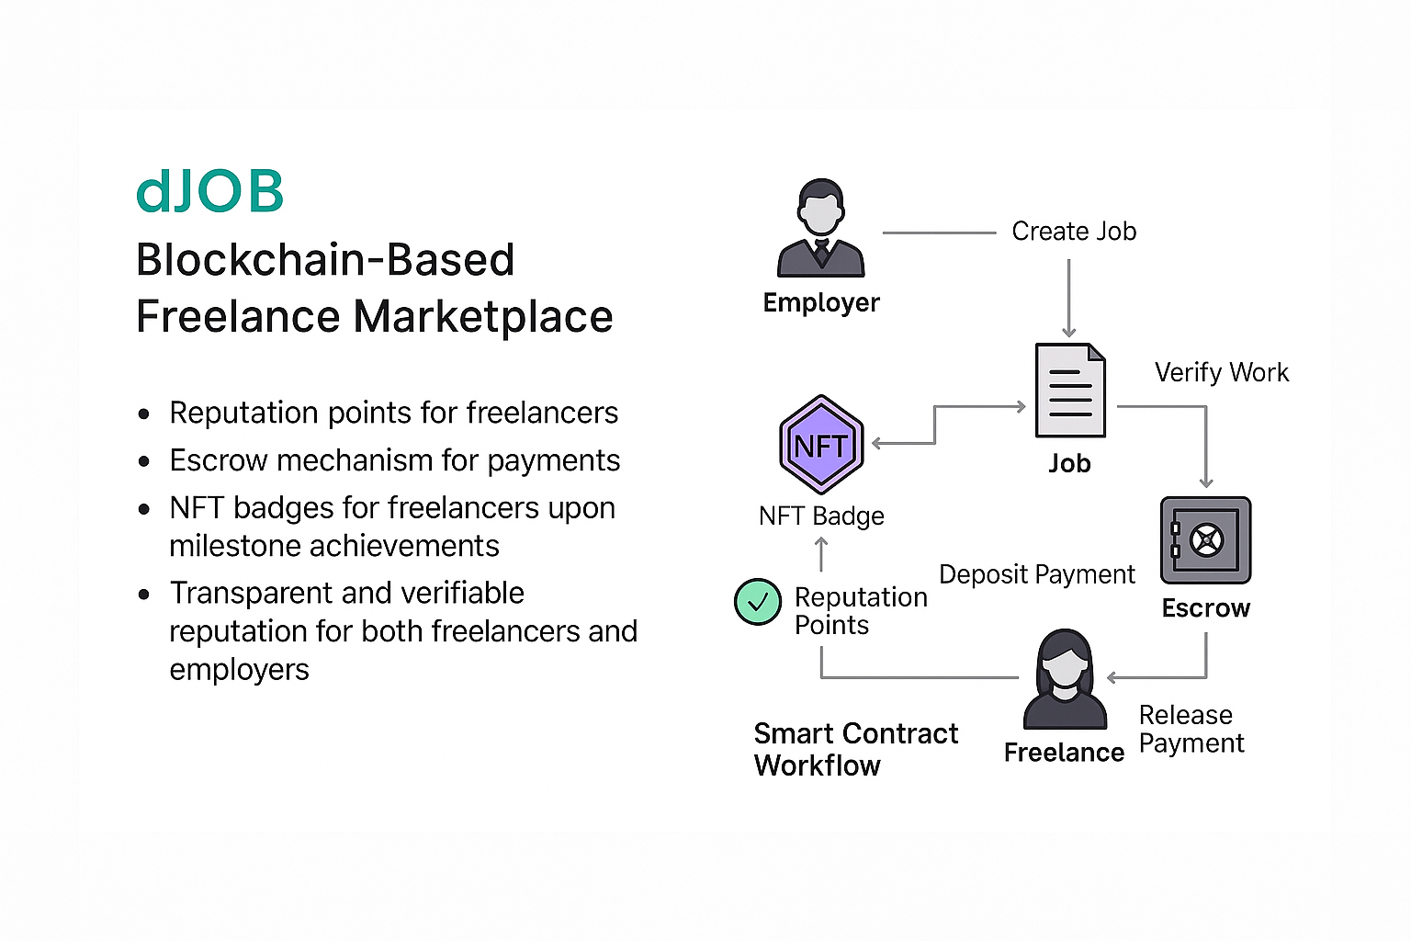

Slide 13
Target Market & Opportunity
Over 1.5 billion freelancers worldwide
Rising demand for decentralized platforms
Early adoption advantage in Web3 freelance economy

Slide 14
Revenue Model
Small transaction fees on job completion
Premium badge minting for advanced recognition
Token staking for visibility boosts

Slide 15
Roadmap
Q2 2025: MVP Launch
Q3 2025: BadgeNFT and DAO Voting Integration
Q4 2025: Mobile App & Multi-chain Expansion
2026: Strategic Partnerships and Scaling

Slide 16
Join Us in Redefining Freelance Work
Support ESCROWLANCE in building a trustless, transparent, and global freelance ecosystem.
Let’s work together to make freelancing fairer and more secure for all.

Slide 17



THANK YOU
OWOLABI ISRAEL
( TTOICRAFT )
@TTOICRAFT
TTOICRAFT

